Slide 1



Sentricare

Slide 2

Committed

Slide 3

Secure

Slide 4

Support

Slide 5
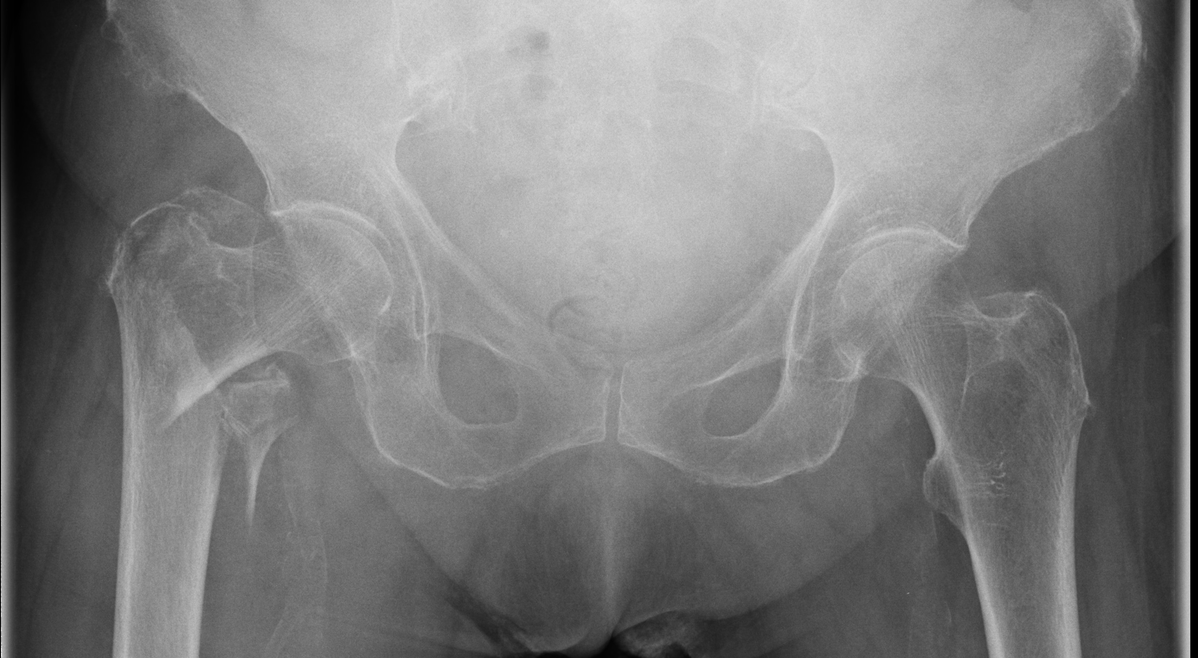
Prevent

Slide 6

Respond

Slide 7

Alert

Slide 8

With You

Slide 9

Always

Slide 10

Safe.

